Slide 1
Introduction: Drugs and Behavior
Lecture 1

Slide 2

Key Terms – what is a drug?
Drug - Any substance, natural or artificial, other than food*, that by its chemical nature alters structure or function in a living organism
*Does the World Health Organization agree?
Legal drug - A drug that is lawful to possess
Illicit drug - A drug that is unlawful to possess or use
What qualifies…?
Psychoactive drug - chemical substance that changes the function of the nervous system and results in alterations of perception, mood/emotional state, cognition/mental state, and behavior
Notes:
*other than those necessary to maintain normal health

Slide 3
Key Terms - Types of Drug Taking behavior
Drug Use
Drug misuse - Use of drugs in greater amounts than, or for purposes other than, those prescribed (use of drug in way other than intended)
Textbook discusses “Deviant drug use” - Drug use that is not common within a social group and that is disapproved of by the majority.
Drug Abuse, Substance Addiction, Drug Dependence…
Refers to cases in which people have struggled to control substance use and have suffered serious negative consequences from that use.
Have all been used interchangeably (*the term “drug abuse” is falling out of favor)
Substance Use Disorder is technical term for diagnosis
Drug use that causes problems (physical, psychological, social, legal, etc.) in person’s life
Continued use despite these negative consequences

Slide 4
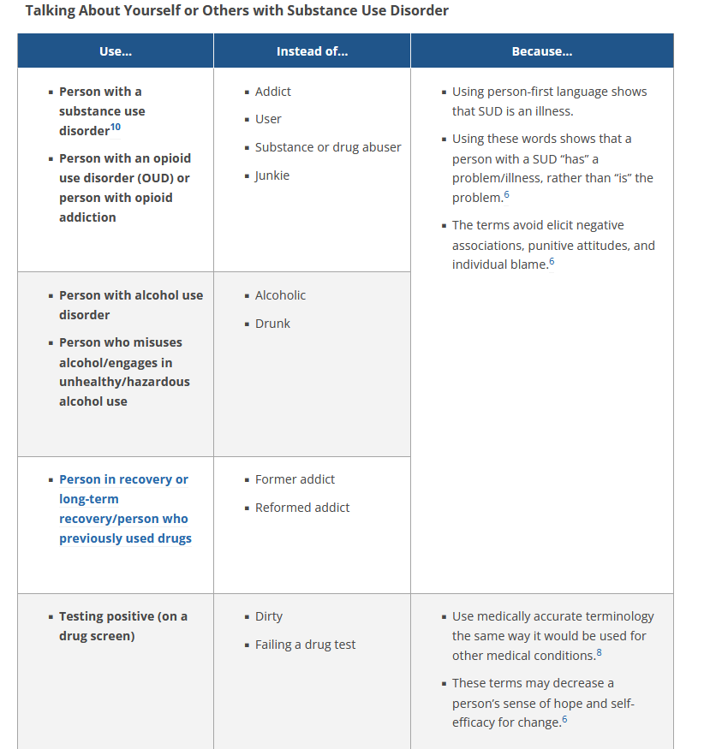
Shift toward the use of Person-First Language by National institutes of Drug Abuse; National Institutes of Alcohol Abuse and Alcoholism

Slide 5
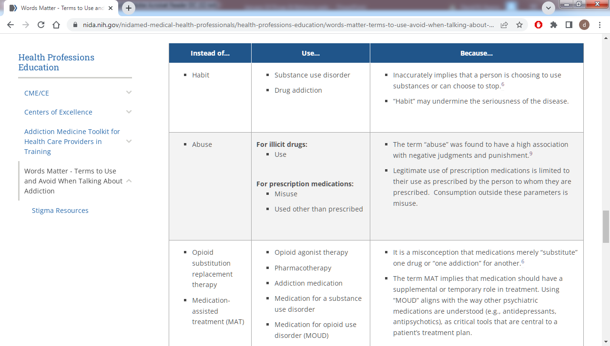
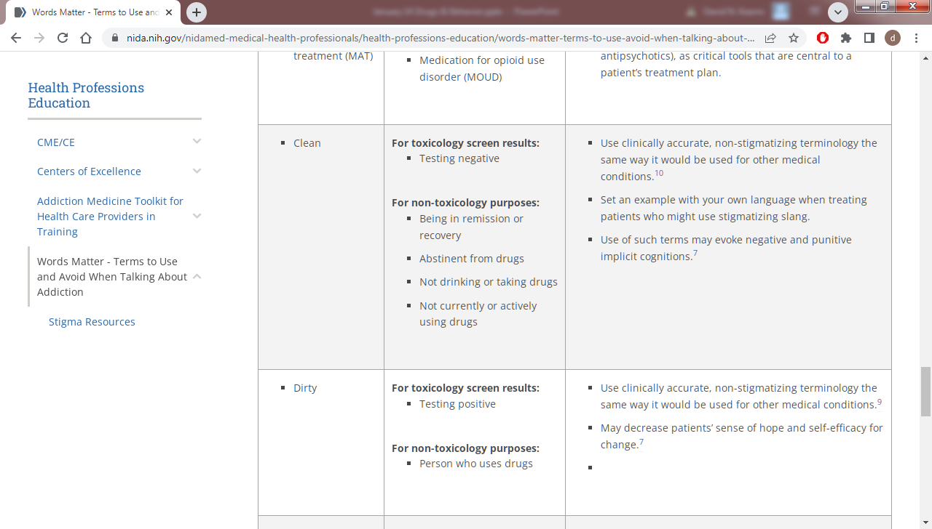

Slide 6
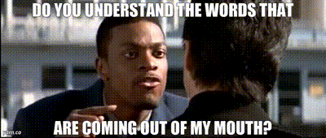
USing PRECISE and Person-First Language
Consider the question “Are drugs harmful to college kids?”
When a term or phrase is ambiguous, its meaning is left uncertain and open to interpretation, as we saw in our example earlier:
What kinds of drug?
How much or how often?
What type of harm?
Define “college kids”.
Consider instead, “Does consuming two ounces of alcohol a day cause liver damage in college students?”
Practice identifying this language in your day-to-day life, and catching yourself when discussing in class

Slide 7
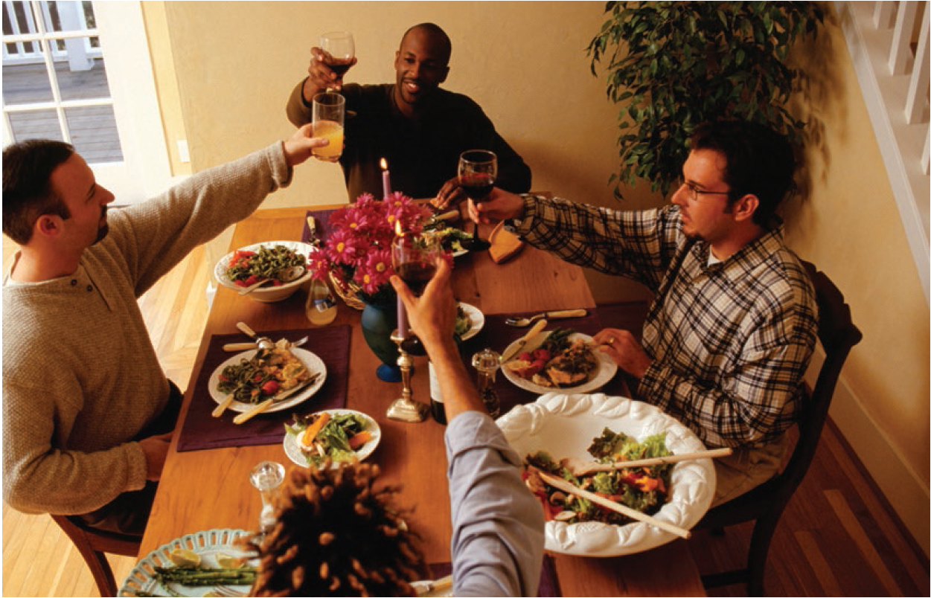
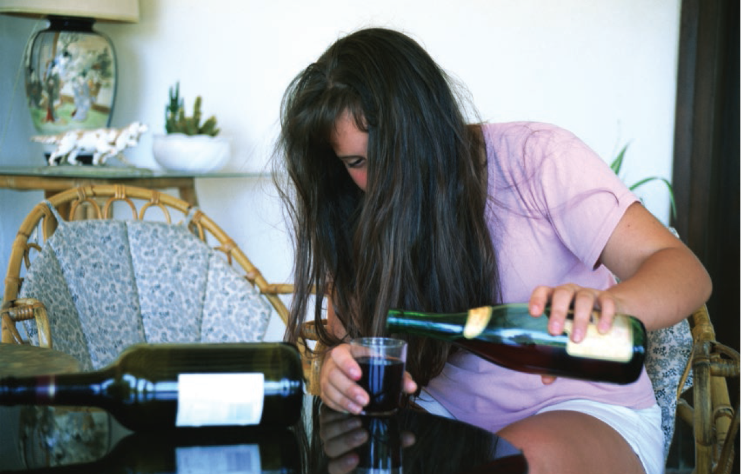
Our concern about the use of a drug depends on what is being used, who is using it, how much is being used, and when, where, and why it is being used.
Notes:
Ask ”who what when where why and how?”

Slide 8
General Principles of Drug use
1) Use is not abuse.
Most users of any given substance do not use it in ways that can be defined as addiction, or a substance use disorder.
2) Every drug has multiple effects.
Positive, negative, and in between
Although a user might seek only one effect, every psychoactive drug acts at multiple sites, both in the brain and on other organs.
3) Amount matters.
Large doses, frequent doses, or taking a drug by a method that results in a lot of the drug getting to the brain quickly can produce very different effects, and more problems, compared with a single or lower dose.
Notes:
Similarly, some users of substances who DO use it in ways that could be defined as substance misuse would never think of their behavior as such.

Slide 9
General Principles of Drug Use
4) User’s history and expectations powerfully influence drug effects.
Experienced users react differently than new users and may report more of the positive effects of a drug.
Expectations influence the experience:
Even first-time users are influenced by peers, family members, especially older siblings (D’Amico & Fromme, 1997), advertising, media (movies, TV, etc).
Bar Lab Experiment: https://www.youtube.com/watch?v=8EWqy6MGpxo https://www.youtube.com/watch?v=BR2_YpocWQk
Notes:
Alcohol ads may have most impact on under 21s (Fleming et al., 2004)
Especially “party ads” – these directly advertise to youth/adolescents

Slide 10
General Principles of Drug Use
5) Drugs are not good or bad.
Any drug that produces effects might produce some benefit when used carefully and has the potential to produce harm when abused.
Blaming the substance affects our efforts to correct drug-related problems by focusing on eliminating the substance and ignoring all the factors that led to the abuse of the drug in the first place.
Notes:
Good =/= legal
Bad =/= illegal

Slide 11
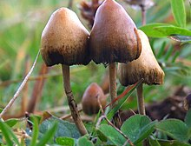

How Did We Get Here?
Drug use is not at all new.
Drugs have been used throughout history…
Enhance spiritual/religious experiences.
Significant roles in the economies of societies in the past.
Treat illnesses.

Slide 12
How Did We Get Here?
However…
Many developments in the past century.
Marketing of legal pharmaceuticals.
Vaccines, antibiotics, birth control medicines, and mental health treatments were introduced.
Government efforts to limit access to certain kinds of drugs
“war on drugs” (we will go intro more depth on this in our history/policy lecture)

Slide 13
Extent of Drug Use
Think back to our exercise at the beginning of the class…
“Yes or No: Rates of drug use have continuously gone up over time.”
in some cases, we don’t know what we don’t know…
It is not easy to get accurate and complete information on:
How much of an illicit drug is imported and sold.
Number of users for illegal drugs such as cocaine
True usage of legal drugs such as alcohol, tobacco, and prescription drugs.
Notes:
Example: dropouts are not counted.

Slide 14
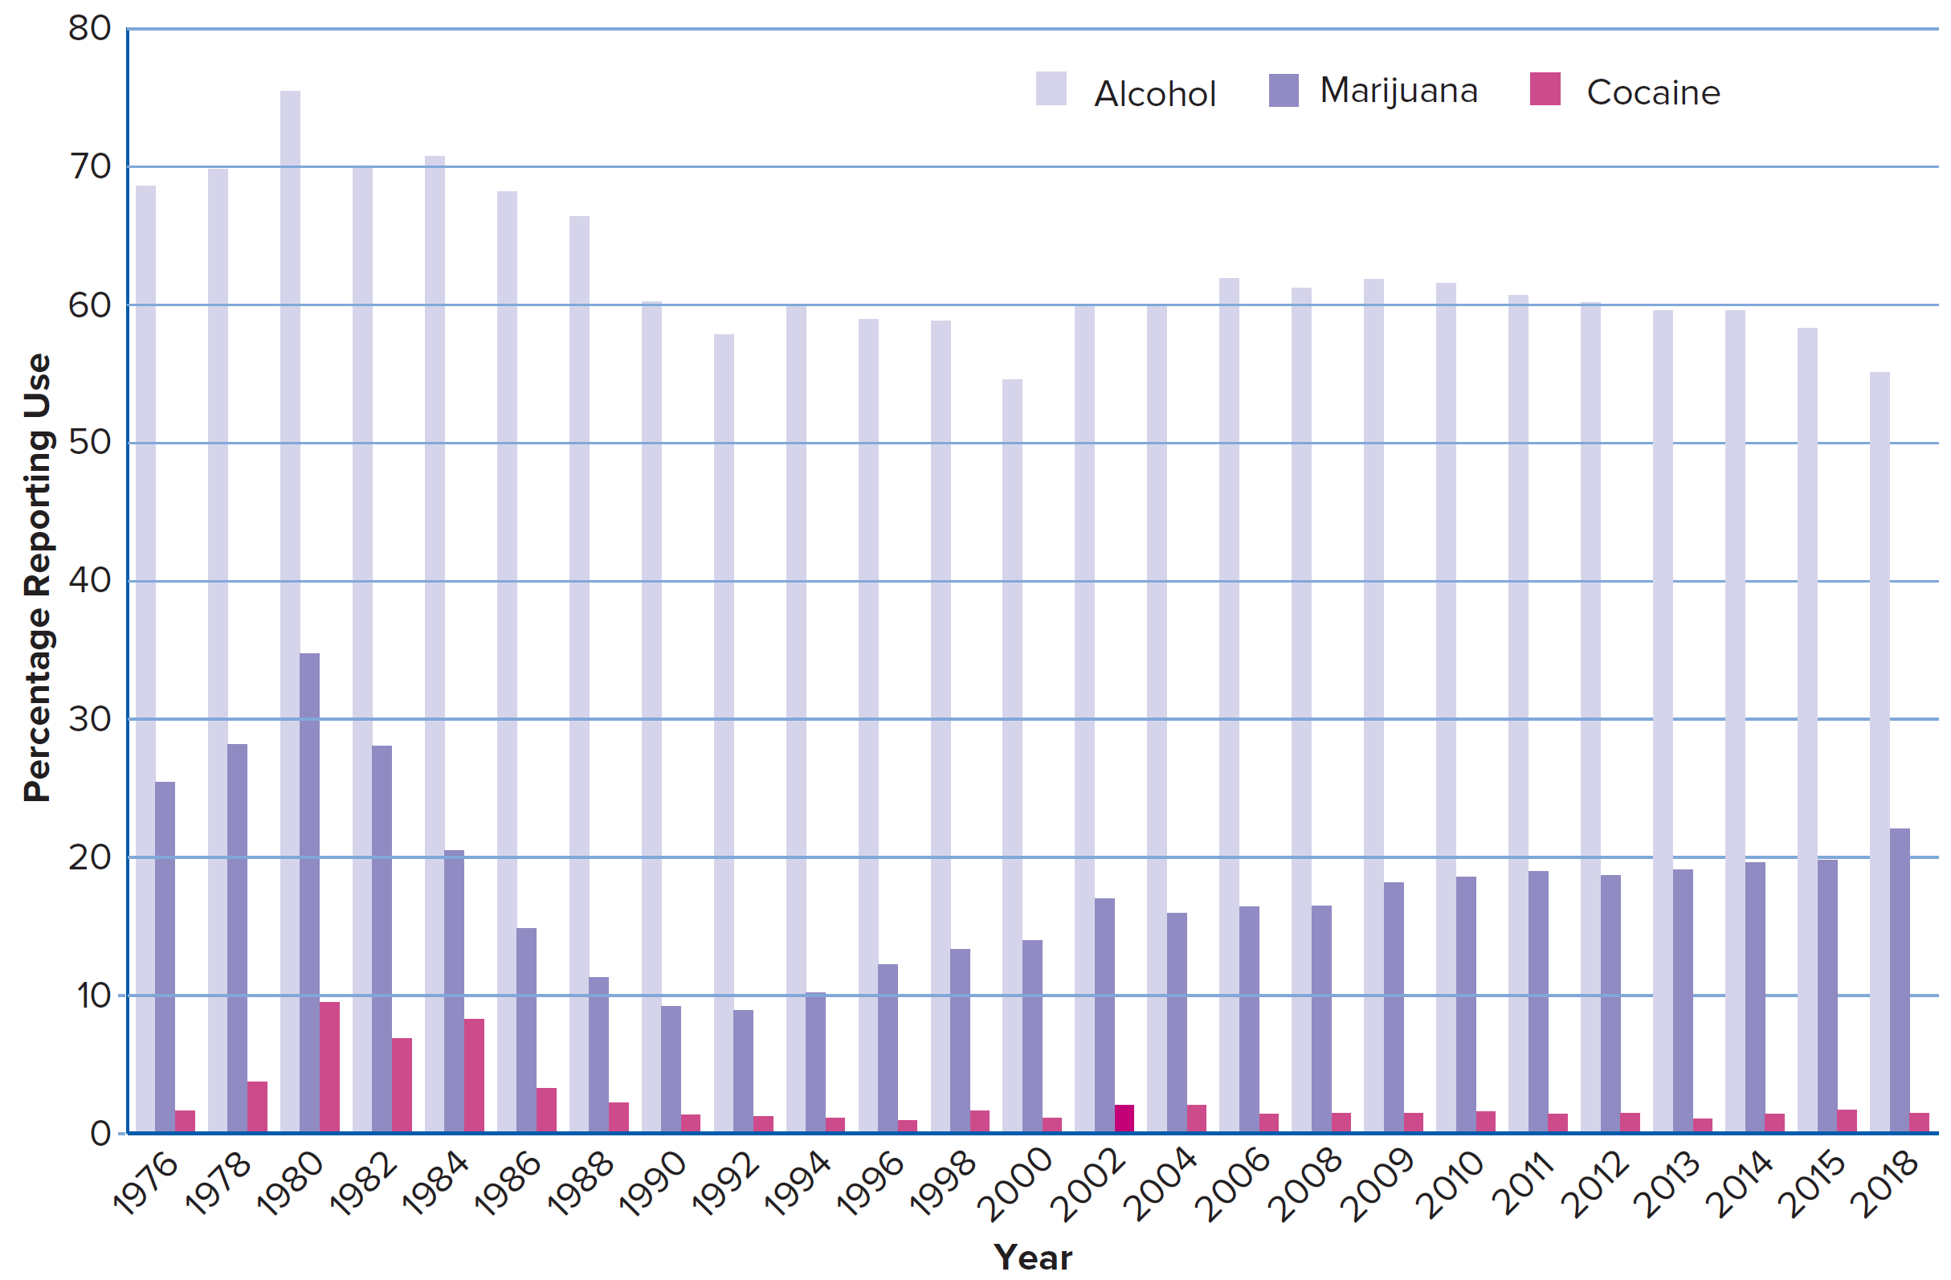
Trends in Reported Drug Use within the Past 30 Days for Young Adults Ages 18 to 25

Slide 15
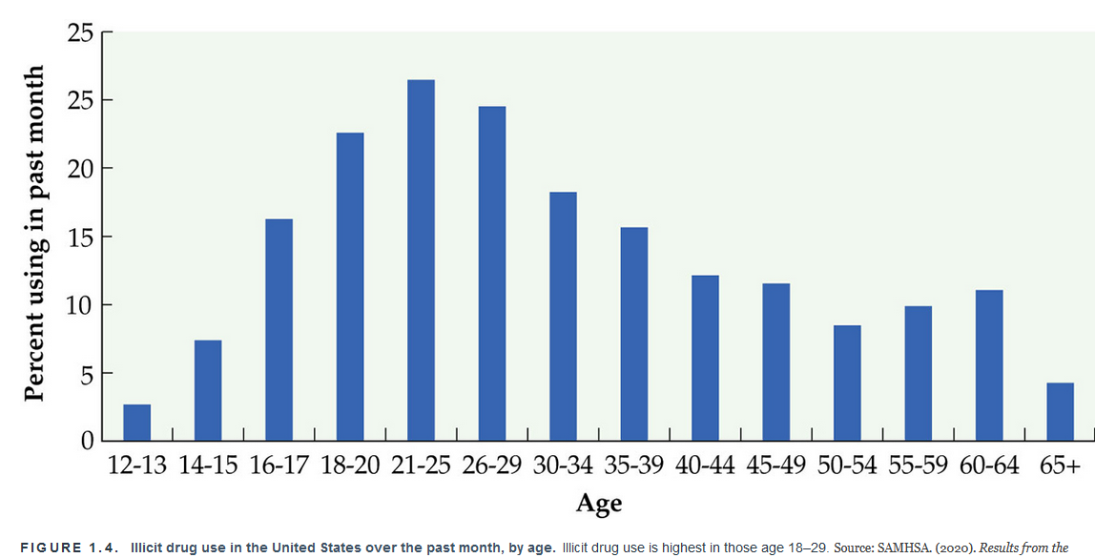
Populations of Users

Slide 16
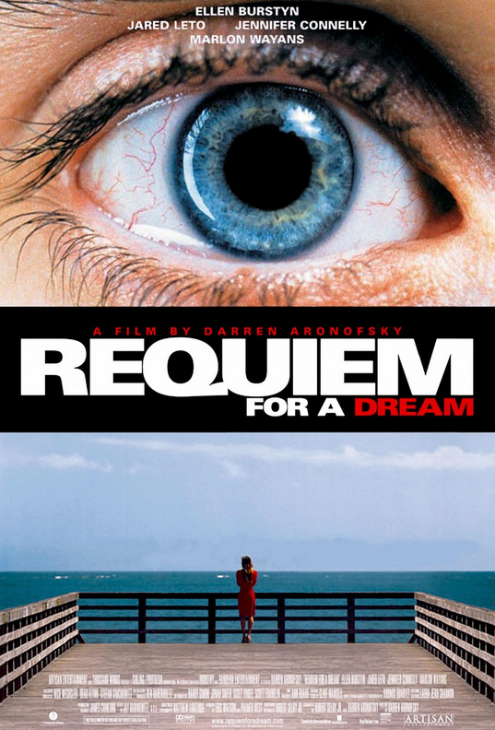
Populations of Users
There is a wide range of rates and amounts of use among people who use a particular substance.
This is true of all psychoactive drugs.
This range of users has important implications for:
Prevention & Treatment efforts.
Law enforcement.
The nature of “dependence”.
Notes:
how can we know how many people are using which drugs?
Is use increasing or decreasing? Which drugs?

Slide 17


Patterns/Trends in Drug Use (via Surveys)
Monitoring the Future study (MTF) :
Gathers data from students.
Conducted annually since 1975.
Types of data collected:
Prevalence of drug use.
Perceived risk and availability of various drugs.
National Survey on Drug Use and Health (NSDUH) :
Gathers data from people ages 12+ in households across the United States.
Conducted annually since 1971.
Face-to-face, computer-assisted interviews.
Types of data collected:
Prevalence of drug use.
Frequency of drug use.
Both shows changes in the trends over time in the rates of drug use.
Notes:
NSDUH: 70k people each year
MTF: Data are collected each year from more than 15,000 high school seniors in schools across the United States, so that nationwide trends can be assessed.
Generally speaking, people 18-25 are the main age group using illicit drugs.

Slide 18
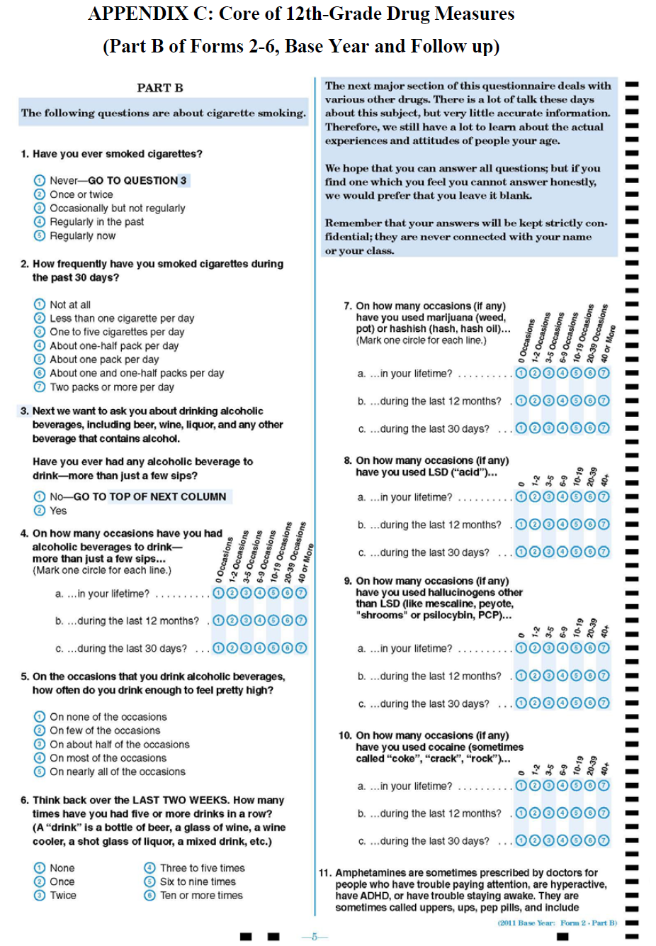
Extent of Drug Use
Much of our information from survey questionnaires.
Easiest way to get a lot of information with minimum effort… but many drawbacks.
1) selection bias
2) validity of self-reported drug use
Notes:
Problems:
1) selection bias
Who is missed?
2) validity of self-reported drug use
Can we assume dishonesty is constant over years?

Slide 19
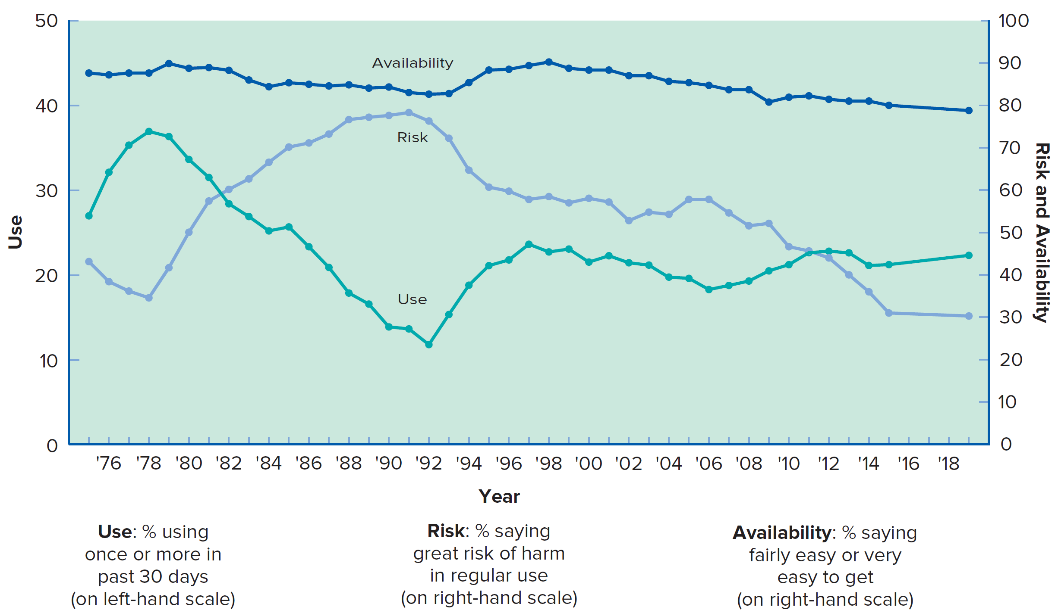
. Monitoring the Future study Marijuana: Trends in Perceived Availability, Risk of Regular Use, and Prevalence of Use in the Past 30 Days for 12th-Graders
The University of Michigan.
Notes:
Relationship between perceived risk and use seems to no longer hold. Why? Data indicate that if the perception of risk of drug use is low, then rates of use are higher and vice versa. Perception of risk differs from the perception of availability.

Slide 20
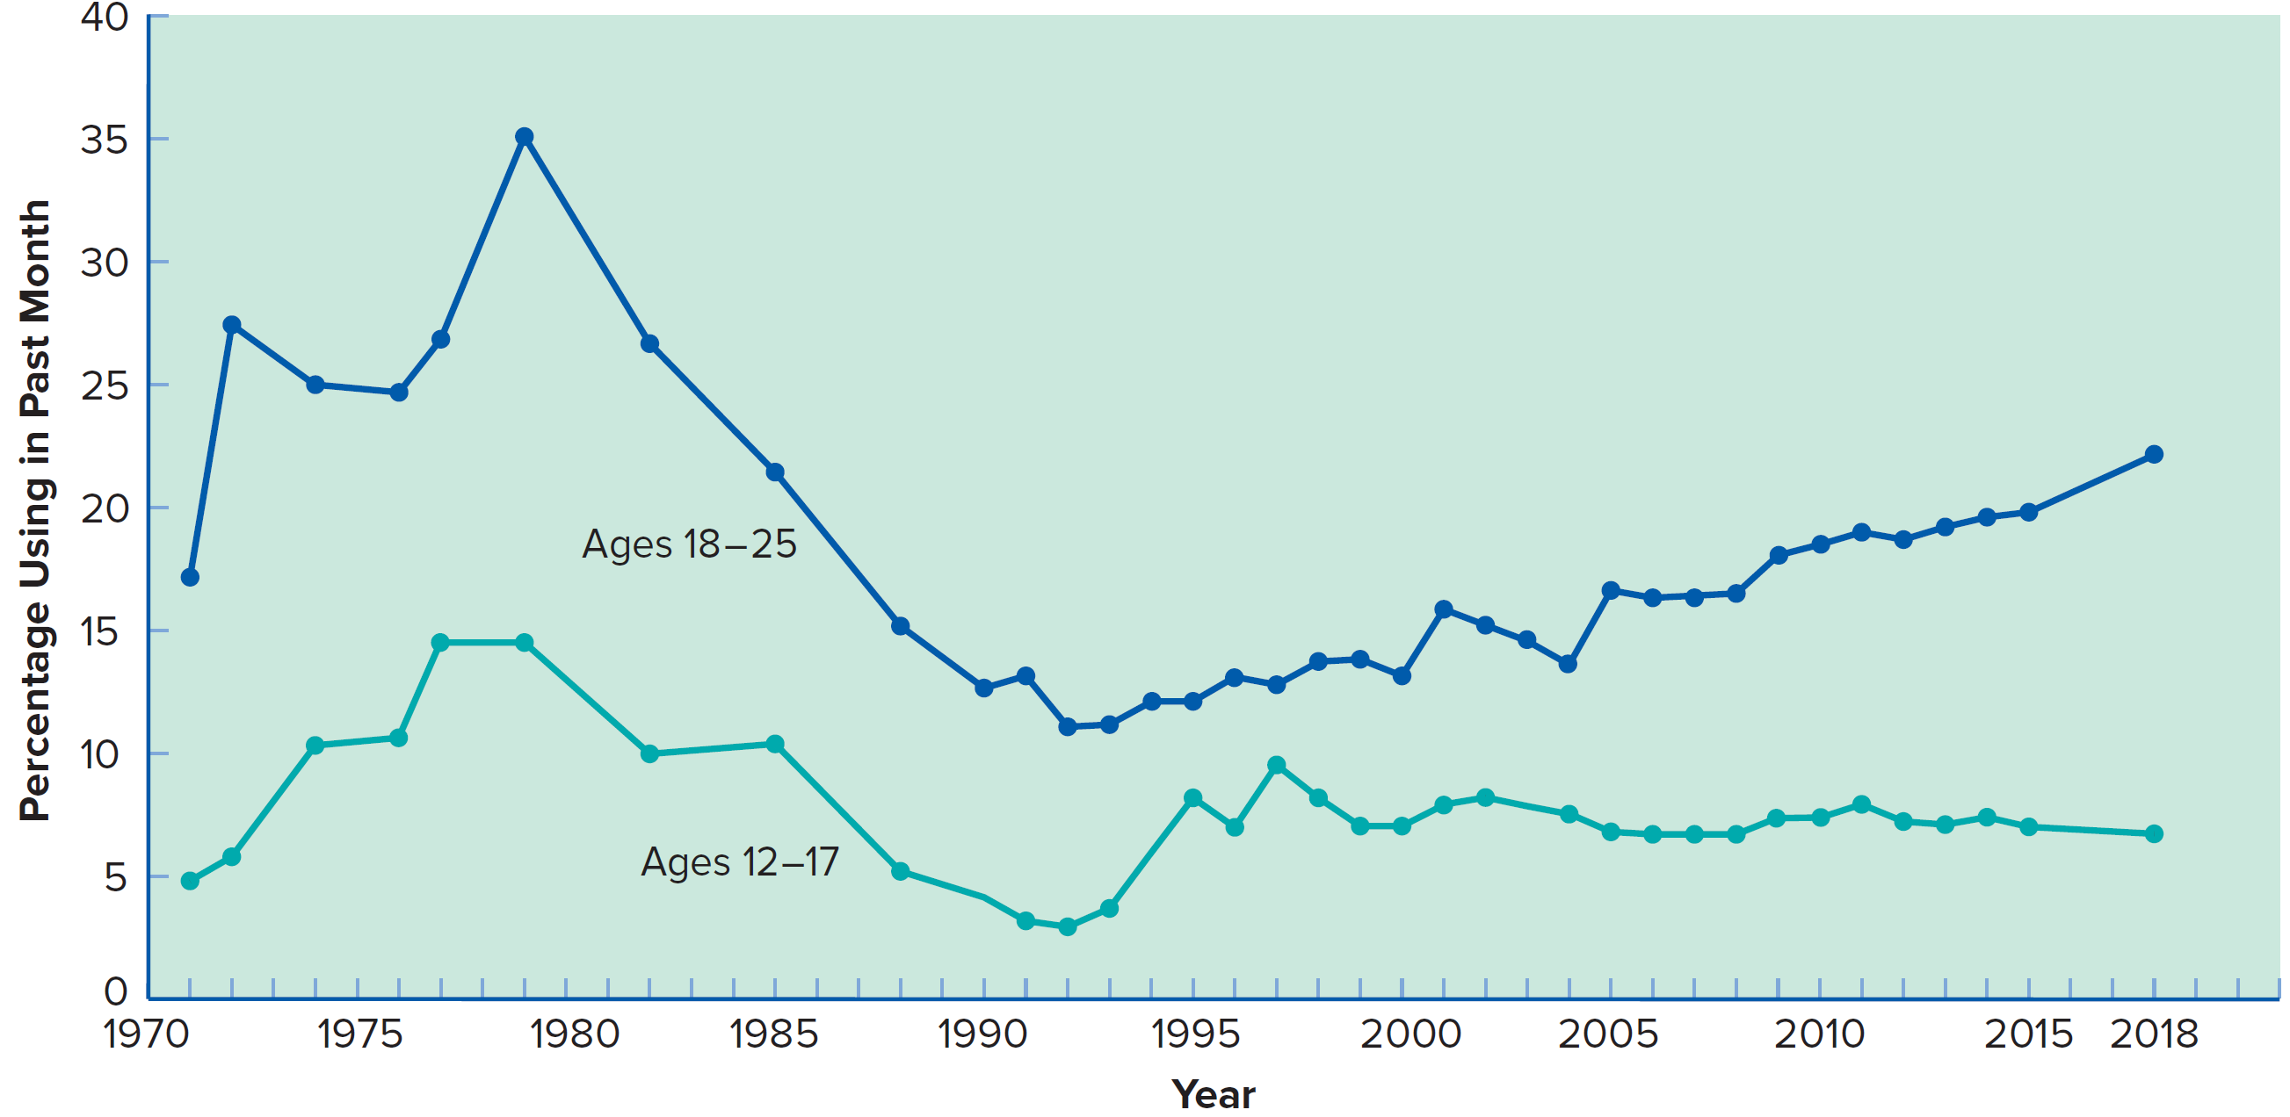
National Survey on Drug Use and Health Trends in Marijuana Use among Persons Ages 12 to 25, by Age Group

Slide 21
National Surveys
Data from Monitoring the Future study (MTF), National Survey on Drug Use and Health (NSDUH), and other large-scale studies can be examined together.
Ongoing epidemiological and etiological research and reporting project.
NSDUH is the primary source of national and state-level data concerning alcohol, tobacco, and drug use.
Patterns found in both surveys are similar.
Indicates that these trends are real and probably reflect broad changes in the American society over time.
Notes:
Information from this study is used by government agencies, policy makers, and researchers to monitor substance use trends and design and support prevention, treatment, and education programs.

Slide 22

Correlates of Drug Use
Correlate - A variable that is statistically related to some other variable
Reminder: This does not necessarily mean it causes that other variable
Much of the research on correlates of drug use has used marijuana smoking as an indicator partly because:
Adolescent marijuana use has been a matter of some concern for some time.
Enough people have tried it so that meaningful correlations can be done.

Slide 23
Risk vs. Protective Factors
Risk factors vs. protective factors - Risk factors are correlated with higher rates/increased drug use, and protective factors are correlated with lower rates/decreased drug use.
Gender
Race and ethnicity
Level of education
Genetics
Personality variables - Play a small role in whether someone decides to try alcohol or marijuana but a larger role in whether that use develops into a serious problem.
“Impulsive” individuals might use drugs at a higher rate.

Slide 24
Factors Associated with Adolescent Marijuana Use
Risk Factors (in order of importance): | Protective Factors (in order of importance):
Having friends who use marijuana or other substances | Perceiving that there are strong sanctions against substance use at school
Engaging in frequent fighting, stealing, or other antisocial activities | Having parents as a source of social support
Perceiving that substance use is prevalent at your school | Being committed to school
Knowing adults who use marijuana or other substances | Believing that religion is important and frequently attending religious services
Having a positive attitude toward marijuana use | Participating in two or more extracurricular activities

Slide 25
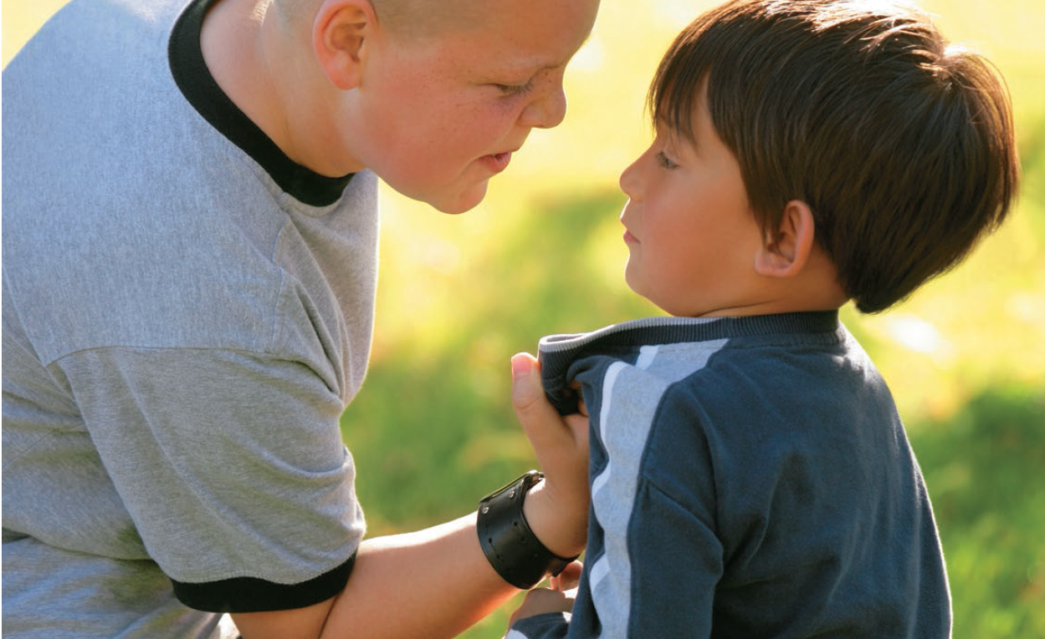
Antecedents of Drug Use
Antecedent - A variable that occurs before an event such as the initiation of drug use.
Not necessarily the cause of drug use.
Examples include…
Aggressiveness.
Conduct problems.
Poor academic performance.
Attachment to a drug-using peer group.
Parent and community norms that support drug use.
Notes:
However, this doesn’t help us understand cause and effect very well. Aka…. Do adolescents first become involved with a deviant peer group and then use drugs, or do they first use drugs and then begin to hang around with others who do the same? Does drug use cause them to become poor students and to fight and steal?

Slide 26
Risk vs. Protective Factors
The terms “risk factor” and “protective factor” sound like they connote causality.
But for almost all these factors we cannot say they cause or prevent drug use…we can only say they are correlates of drug use.
Being in fights at school is a risk factor for marijuana use… does fighting cause marijuana use?
What are the three possible causal relationships when two variables are correlated?

Slide 27
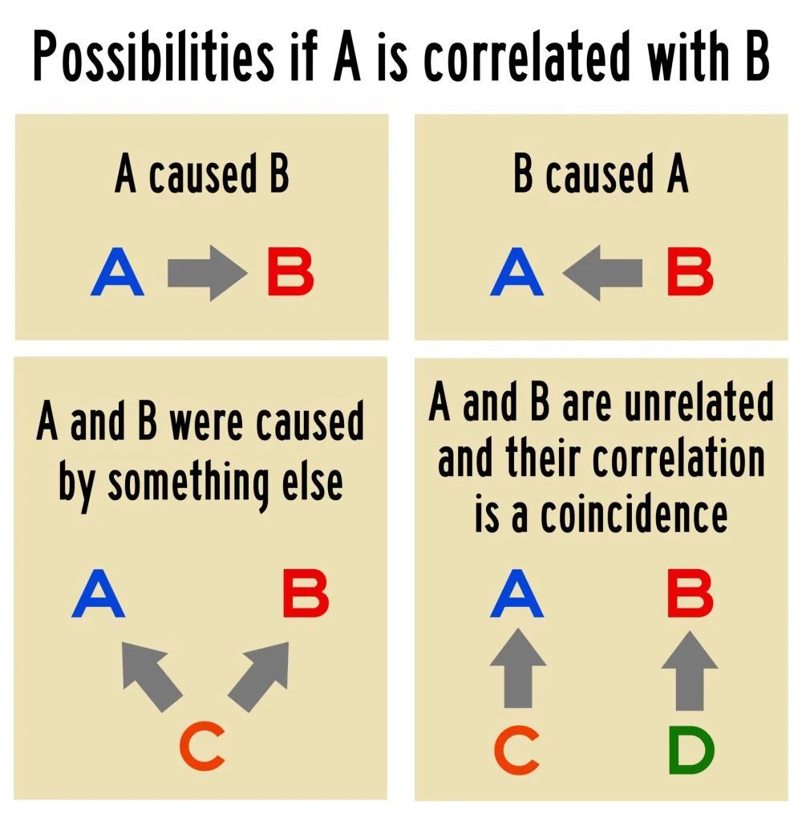

Slide 28
Three possible causal relations that can explain correlation.
1) Fighting causes marijuana use.
2) Marijuana use causes fighting.
3) A third variable causes both fighting and marijuana use.
What other ‘3rd’ variables might there be?

Slide 29
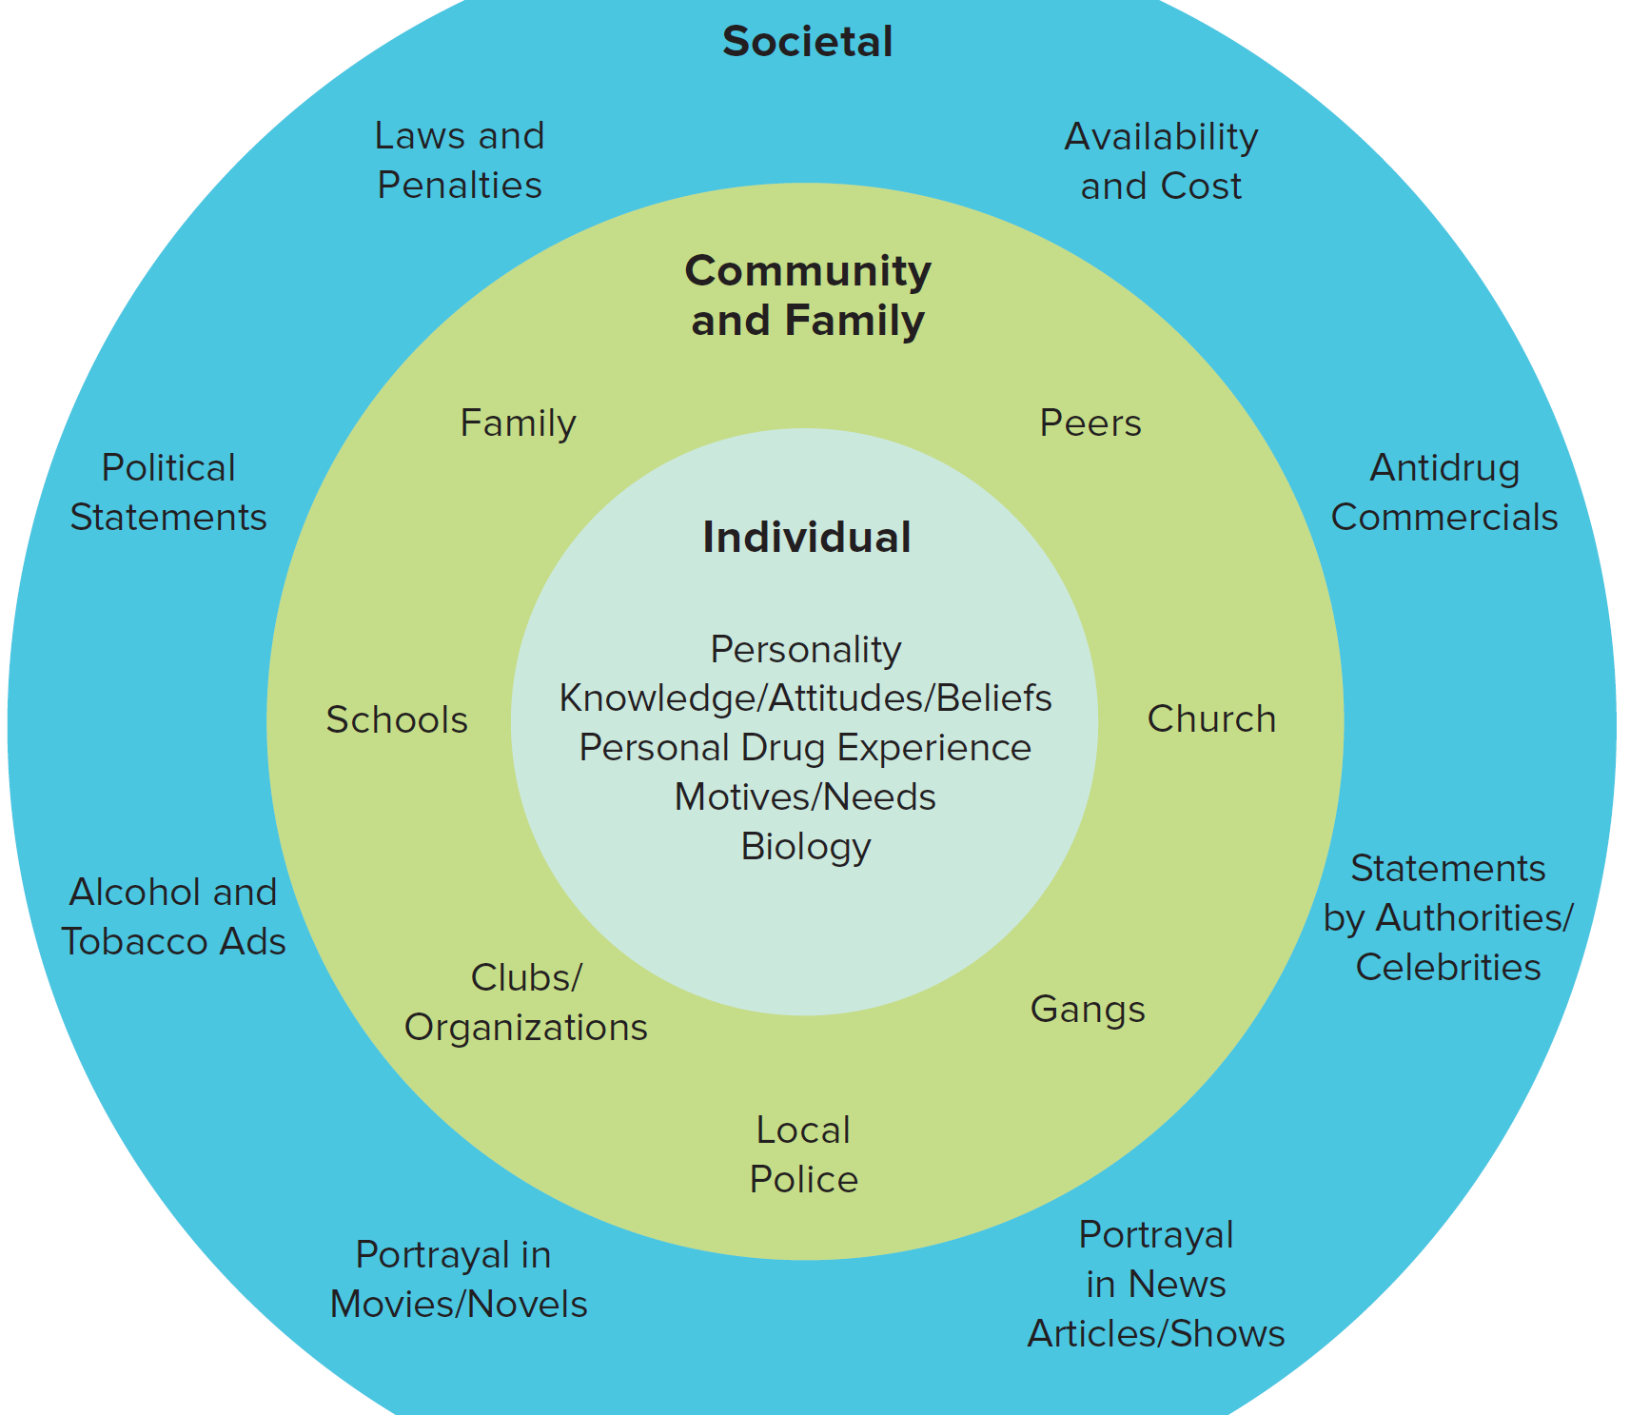
Influences on Drug Use
Notes:
Although societal, community, and family factors play an important role in determining whether an individual will first try a drug, with increasing use the individual’s own experiences with the drug become increasingly important

Slide 30
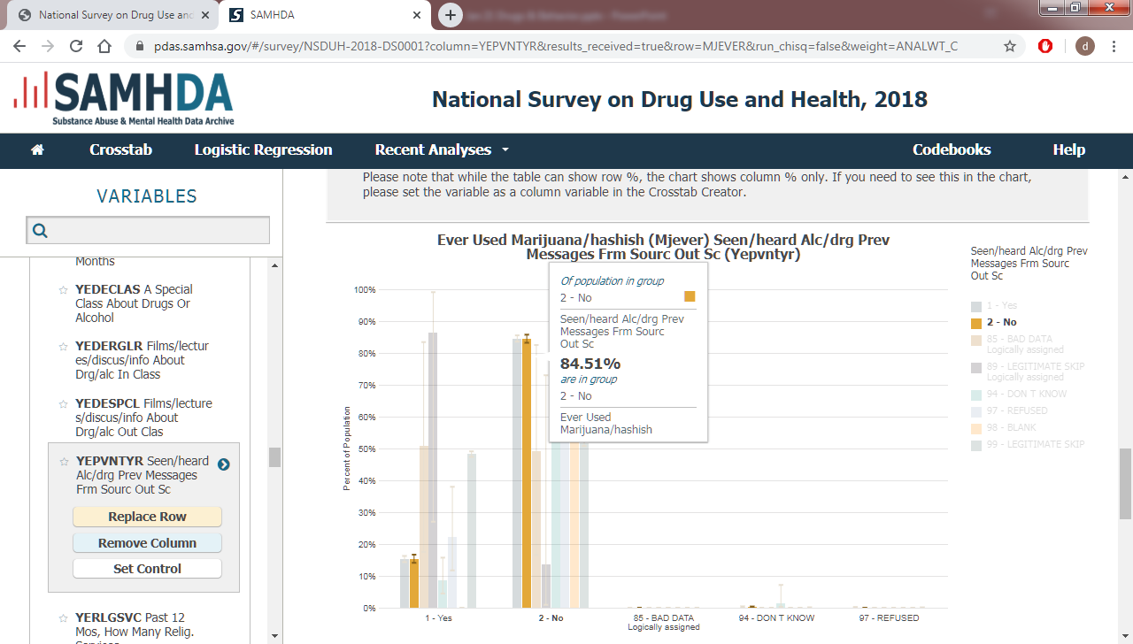
Drug Public Service Announcements
Are drug PSAs (public service announcements) a protective factor against drug use?
https://www.youtube.com/watch?v=GOnENVylxPI
https://www.youtube.com/watch?v=iE7ukc7MV-k

Slide 31
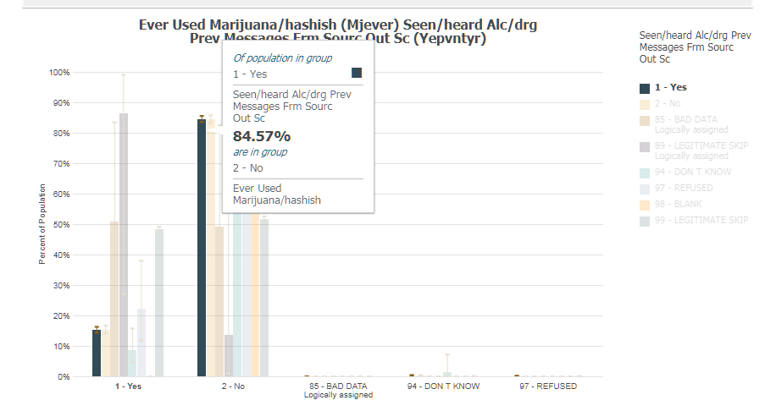

Slide 33
Extent of Drug Use
Be careful of media reports!
Anecdotes vs. Empirical Data
Can you overdose on fentanyl just by touching it or being near it?
https://www.youtube.com/watch?v=2TkBKCEecuQ&ab_channel=ABC10News
https://www.youtube.com/watch?v=iPD8v5fewo0&ab_channel=ABC10News
Notes:
Example of anecdotes gone viral…
You will have a chance to thoroughly examine such a report at the end of the course

Slide 34
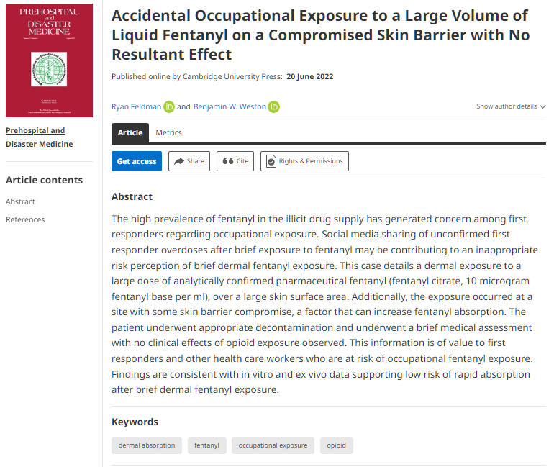
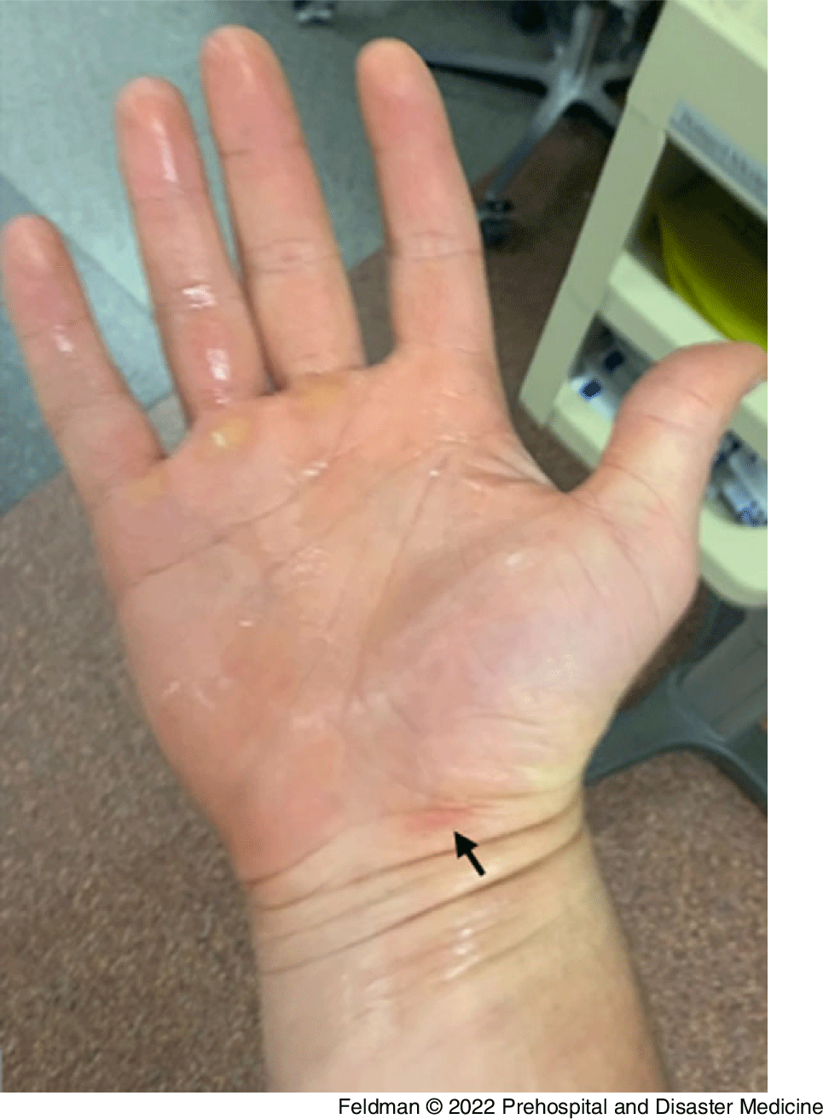
https://www.cambridge.org/core/journals/prehospital-and-disaster-medicine/article/accidental-occupational-exposure-to-a-large-volume-of-liquid-fentanyl-on-a-compromised-skin-barrier-with-no-resultant-effect/1D102C667E98D303AA494FD7136DAEAE

Slide 35
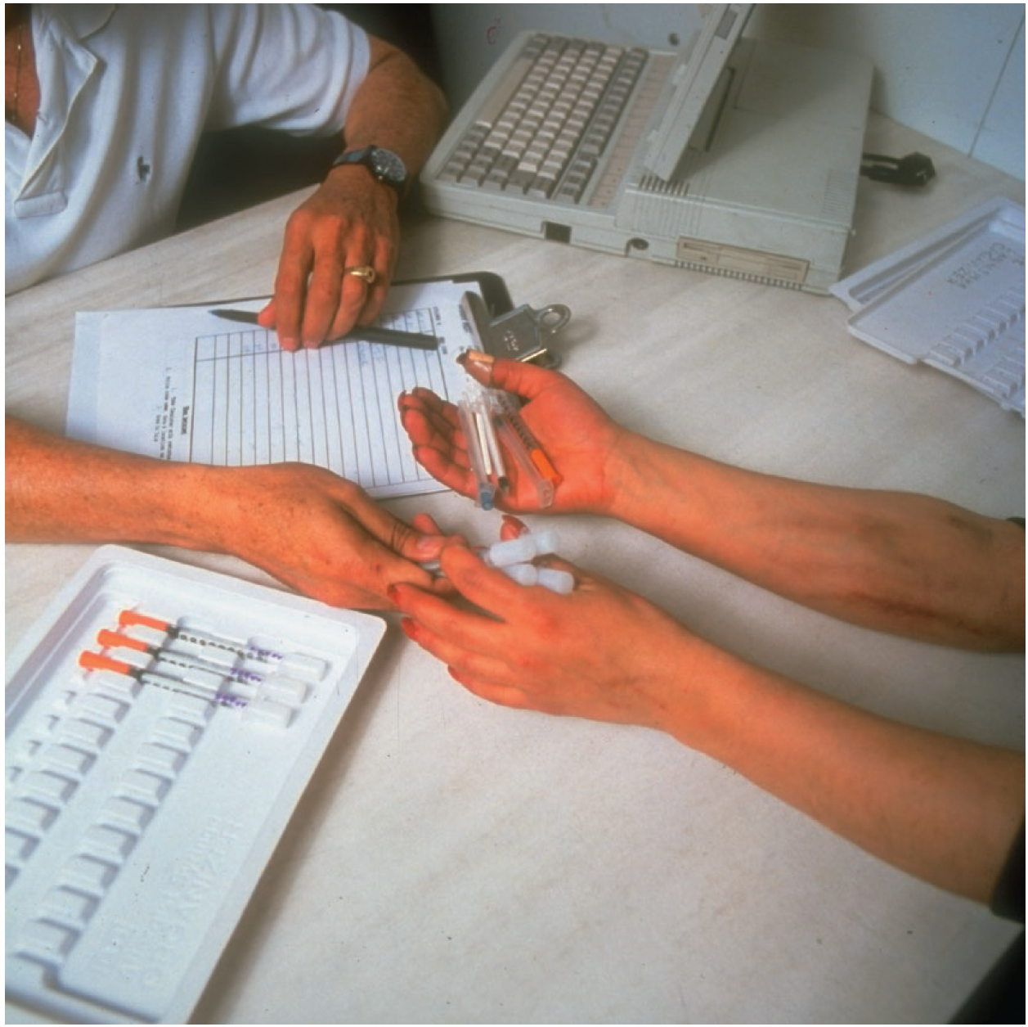
Key terms - Drug-Related Toxicity
Toxic - poisonous, deadly, or dangerous.
potentially different connotations for the word ‘toxic’: Physiological vs. behavioral.
Specific toxicities - not due to the action of the drug itself, such as blood-bourne diseases and the life-threatening liver infections, hepatitis B and hepatitis C, for those who inject drugs.
Acute versus chronic toxicity.
Acute – effects after a single administration
Prescription painkiller overdose can slow the respiration rate to dangerously low levels.
Behavioural impairment due to drug intoxication.
Chronic – effects due to long-term exposure of the drug
High blood pressure.
Neurological damage.
Liver damage.

Slide 36
Trends in toxicity?
CDC tracks overdose deaths
Based on (1) causes of death (2) cited on death certificates
Not the best stats/data…textbook explains why (overcounting)
Not included are deaths from things like AIDS, hepatitis B, etc., or deaths from chronic toxic drug effects.
So total deaths related to drug use are likely higher than overdose deaths

Slide 37
Overdose death rates for all drugs combined
Context: Covid-19 death rate was about 100 per 100,000 per year in U.S. in 2020 and 2021 (averaged)
https://www.cdc.gov/nchs/products/databriefs/db457.htm

Slide 38
Overdose death rates for all opioids
Discussion:
What information do these graphs display well? What information does it obscure?
Notes:
Textbook is somewhat dismissive of idea that there is a drug overdose epidemic. What do you think?

Slide 39
The caveats of Summary statistics
Those were national overdose death stats
When you look locally, you may see a very different picture…
Notes:
Some areas with very high rates, others with very low rates…

Slide 40
how can we understand and determine CAUSALITY?
Notes:
With such immense influence on the perception of drugs and their use,

Slide 41
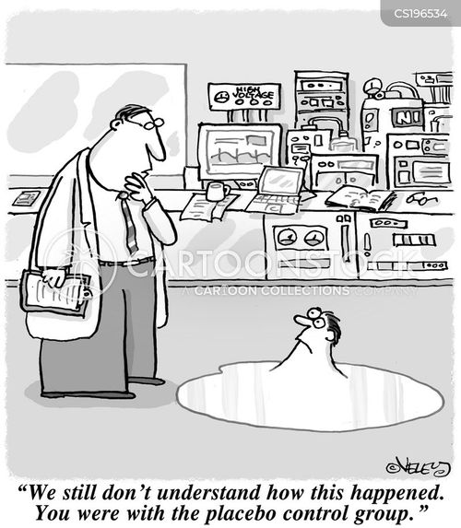
Scientific research to understand drugs and behavior
Unlike biases, cultural norms and expectations toward drugs, scientific research and studies can maintain objectivity when asking and assessing tough questions.
The aim is to report evidence that is based on empirical data, in contrast to anecdotal evidence, which is typically based on one person’s casual observation or perception.

Slide 42
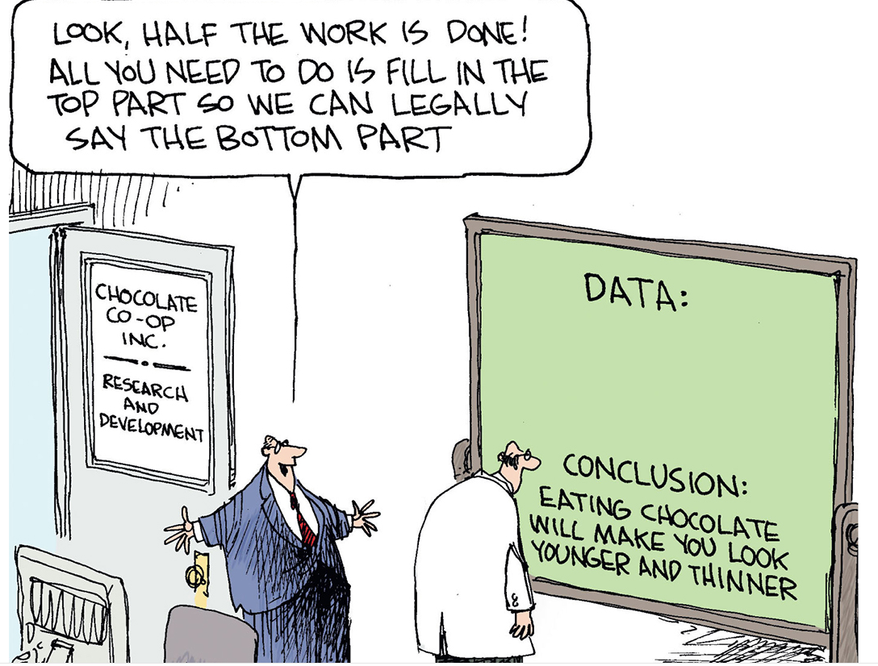
Conducting Safe, Ethical, and Unbiased Studies
KEY TERMS:
Confirmation Bias – the tendency to search for, favor, and remember information that confirms one’s previous beliefs
Informed Consent – a process by which a participant confirm their willingness to participate after being told what to expect in study related procedures (risks, benefits, etc)
Peer-Review Process – the process by which scholarly work is subjected to the scrutiny of other experts in the field – independent reviewers can assess the value of the work and check inconsistencies
Notes:
Participants can withdraw at any time and cannot be compelled to participate in the study

Slide 43
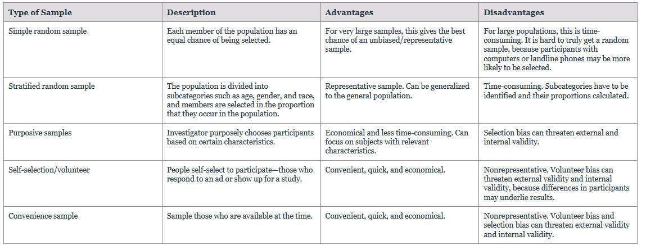
consider the study population…

Slide 44
Let’s Discuss marijuana and fighting again…
Need an experiment to determine causality.
From our previous example, suppose we wanted to test possibility #2, marijuana use causes fighting.
What are the independent and dependent variables?
What experiment would test this? What type of population would you select?
Is such an experiment feasible?
Notes:
Independent – factor that is controlled by research
Dependent – what is observed and measured

Slide 45
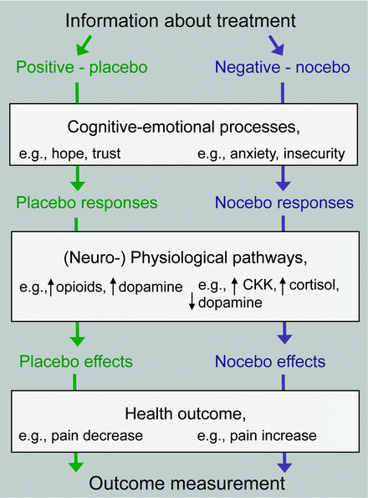
Key Terms - Research on drugs
Good scientific research uses “controls” to account for factors where bias and experience may play a role
Placebo – an inert substance that provokes perceived benefits
Nocebo – an inert substance causes perceived harm
Internal Validity – the degree to which a research design enables confidence of a causal relationship between the independent variable and the changes in behavior
External Validity – measure of how well the findings of the experiment apply to other settings (real world)

Slide 46
Research on drugs
Always consider the quality and vetting of information:
How do we “find” or “do” good scientific research?
1) Does the study ask specific research questions? (precise language reminder!)
2) Have they carefully considered the study population?
3) Have they chosen an appropriate method of investigation?
4) Have they carefully controlled for outside variables to the greatest extent possible?
5) Avoid stigmatizing questions* and confirmation bias?

Slide 47
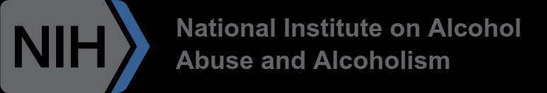
Stigma and scientific research
Social stigma is the disapproval of, or discrimination against, an individual or group based on perceived characteristics that serve to distinguish them from other members of a society.
Stigma is a well-documented barrier to health seeking behavior, engagement in care, and adherence to treatment.
Although most research is intended to reduce stigma, stigmatizing research can exist, as well as research not meant to be stigmatizing being used as such.

Slide 48
What are the components of stigmatizing research
Stigma may be understood as convergence of the following components:
The identification and labeling of human differences.
The linking of labeled persons by dominant cultural belief to undesirable characteristics and formation of negative stereotypes.
Separation of people into categories of “us” and “them” by applying said stereotypes.
The experience of loss of status and discrimination by labeled persons, the ultimate output of the stigma process.
The exercise of social, economic, political, or other power that reinforces the above processes, translating them into significant consequences for labeled individuals.
Source: All of Us Policy, 2020

Slide 49
Broader consequences of stigma…
Only 6.5% of people with a SUD receive treatment.

Slide 50

Keep in mind, this was just an overview, Only the tip of the iceberg….
summary
Practice being wary when you see bold headline claims… a single sentence is rarely enough to capture the big picture and nuances of the scientific research.
Good research on drugs, particularly drugs of abuse, is challenging, complex, and very nuanced!
Notes:
We’ll be coming back to these concepts again and again throughout the course.

